Slide 1

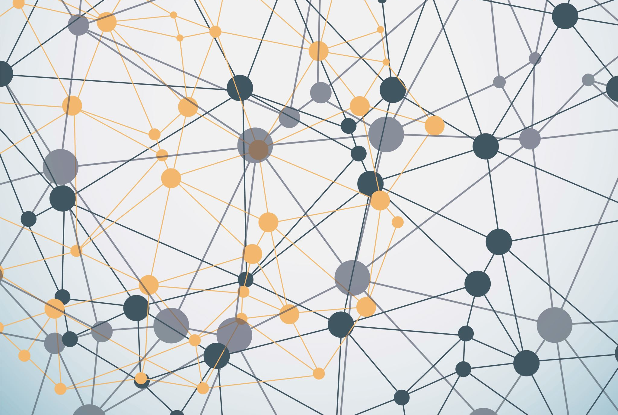

Python Fundamentals
Innovation Masters
Day 18

Slide 2
Today’s Agenda
Finish the personal finance app
Implement file read/write
Introduction to GUI
Making a small program
Tech Talk

Slide 3
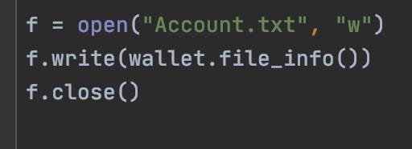




File write

Slide 4
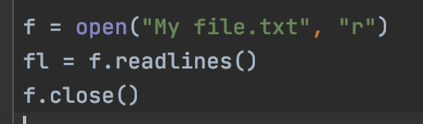













File read

Slide 5
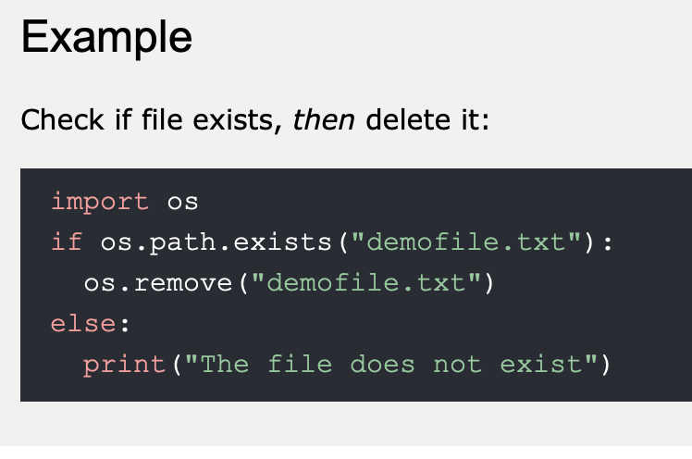
Check if file exists

Slide 6
Graphical User Interface

Slide 7
GUI
We will take a new approach to learning GUI
We will place ourselves in the shoes of a professional programmer
We will study code from others online to understand how to implement GUI
This practice will build confidence in your own learning abilities
Reduces the need to always rely on the teacher
You will also be teacher’s assistant today and help me make this slide

Slide 8
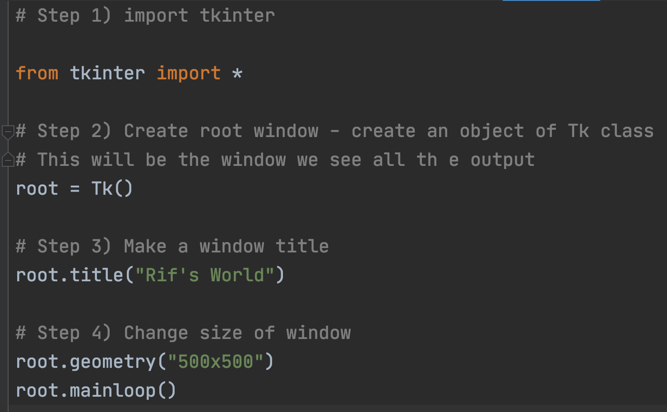
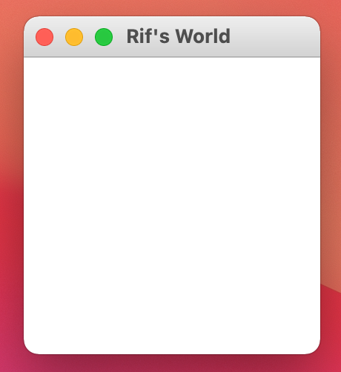
Hello World in tkinter

Slide 9
Tech Talk
Earth’s gravity pulls everything towards it at the same acceleration
https://youtu.be/E43-CfukEgs
https://www.youtube.com/watch?v=IvdohUPWg-0

